Slide 1
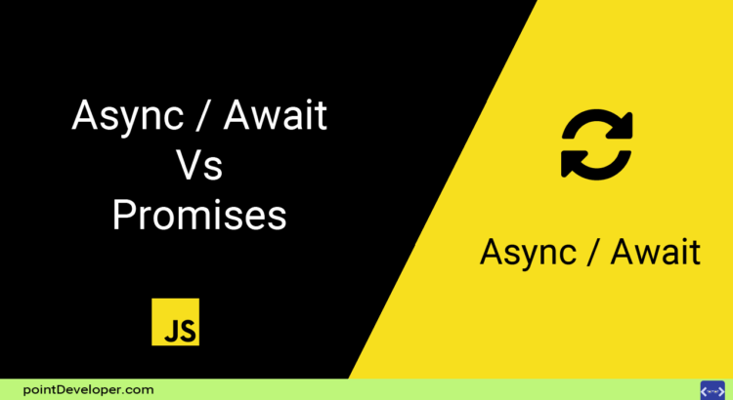

Slide 2
Synchronous
function fnWorkSecond() {
console.log("Work Second");
}
function fnWorkFirst() {
console.log("Work First");
}
fnWorkFirst();
fnWorkSecond();
Output
Work First
Work Second

Slide 3
Asynchronous
function fnWorkSecond() {
console.log("Work Second");
}
function fnWorkFirst() {
console.log("Work First");
}
setTimeout(fnWorkFirst, 1000);
fnWorkSecond();
Output
Work Second
Work First

Slide 4
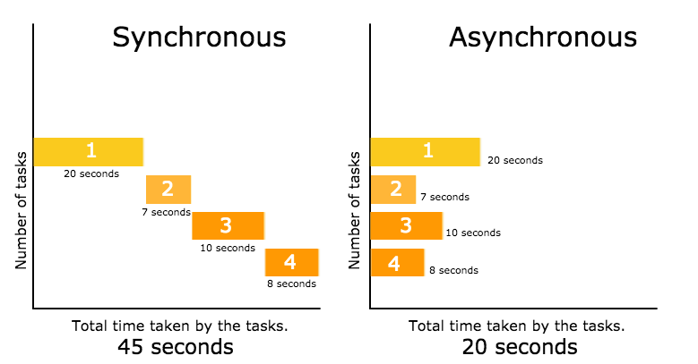

Slide 5

JavaScript Callback

Slide 6
Callback
function fnWorkSecond() {
console.log("Work Second");
}
function fnWorkFirst() {
console.log("Work First");
fnWorkSecond();
}
fnWorkFirst();
Output
Work First
Work Second

Slide 7
Callback(2)
function fnWorkSecond() {
console.log("Work Second");
}
function fnWorkFirst(callback) {
console.log("Work First");
callback();
}
fnWorkFirst(fnWorkSecond);
Output
Work First
Work Second

Slide 8
Callback(3)
function fnWorkSecond(data_back) {
console.log("Work Second");
console.log(data_back);
}
function fnWorkFirst(callback) {
console.log("Work First<");
callback("send data back");
}
fnWorkFirst(fnWorkSecond);
Output
Work First
Work Second
send data back

Slide 9
Callback(4)
function fnWorkFirst(callback) {
console.log("Work First");
callback("send data back");
}
fnWorkFirst(function (data_back) {
console.log("Work Second");
console.log(data_back);
});
Output
Work First
Work Second
send data back

Slide 10
Call Stack
Code
Call Stack
Output
const fn1 = () => {
console.log('fn1')
}
const fn2 = () => {
fn1()
console.log('fn2')
}
fn2()
fn1
fn2
fn1
fn2
Main

Slide 11
Call Stack + Callback
Code
Call Stack
Output
const fn1 = () => {
console.log('fn1')
}
const fn2 = () => {
setTimeout(fn1, 100)
console.log('fn2')
}
fn2()
100ms
fn1
fn1
setTimeout
fn2
fn1
fn2
Main

Slide 12
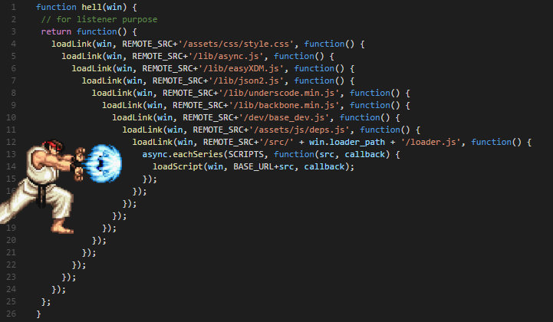
Callback Hell

Slide 13
function loadNews(callback){
//Simulate ajax load data
setTimeout( () => {
callback([
{id:1, title: 'a'},
{id:2, title: 'b'},
{id:3, title: 'c'},
{id:4, title: 'd'},
{id:5, title: 'e'},
{id:6, title: 'f'},
{id:7, title: 'g'},
{id:8, title: 'h'},
])
} , 1000)
}
loadNews(function (result){
console.log(result)
})
console.log('Not Blocking');
Output
Not Blocking
[Object , Object , Object , Object , Object , Object , Object , Object]

Slide 14
function loadNews(callback){
//Simulate ajax load data
setTimeout( () => {
callback([
{id:1, title: 'a'},
{id:2, title: 'b'},
{id:3, title: 'c'},
{id:4, title: 'd'},
{id:5, title: 'e'},
{id:6, title: 'f'},
{id:7, title: 'g'},
{id:8, title: 'h'},
])
} , 1000)
}
loadNews(function (result){
validateNews(result, function(news){
sortByLatest(news, function(latest){
latest5News(latest, function(final){
console.log('final');
console.log(final)
})
})
})
})
console.log('Not Blocking');
Output
Not Blocking
…

Slide 15


Slide 16


Slide 17
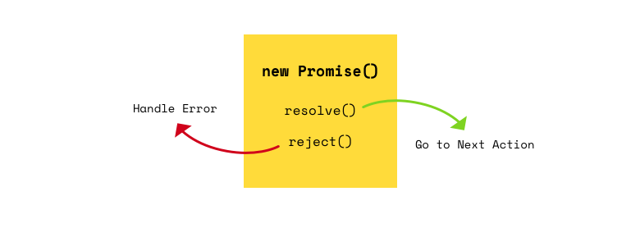

Slide 18
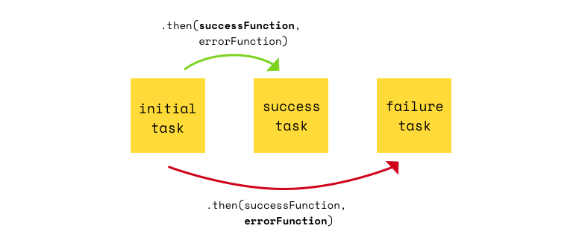

Slide 19
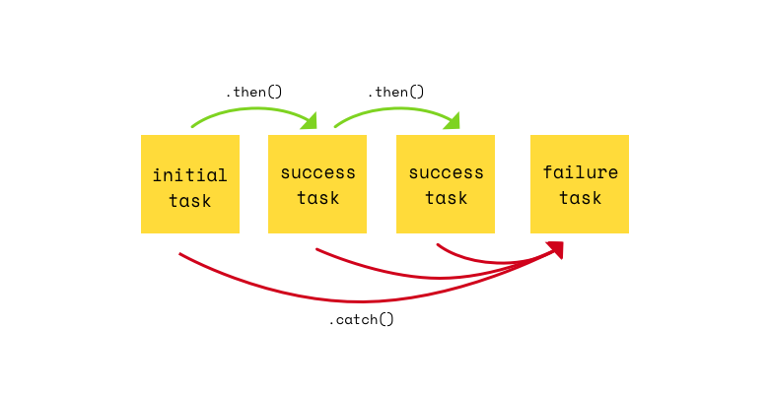

Slide 20
Promise Resolve
const a ='a'
const ap = new Promise( (resolve) => {
setTimeout( () => {
resolve('a')
}, 1000)
})
console.log(a)
console.log(ap)
Output
a
Promise{…}
a
xxxa
ap.then(e => {
console.log(e)
return 'xxx' + e
})
.then(e => {
console.log(e)
})

Slide 21
Promise Reject
const a ='a' const ap = new Promise( (resolve, reject) => {
setTimeout( () => {
//resolve('a')
reject('error')
}, 1000)
})
console.log(a)
console.log(ap)
ap.then(e => {
console.log(e)
return 'xxx' + e
})
.then(e => {
console.log(e)
})
.catch(e => {
console.log(e)
})
Output
a
Promise{…}
error

Slide 22
Callback To Promise
function loadNews(callback){
//Simulate ajax load data
setTimeout( () => {
callback([
{id:1, title: 'a'},
{id:2, title: 'b'},
{id:3, title: 'c'},
{id:4, title: 'd'},
{id:5, title: 'e'},
{id:6, title: 'f'},
{id:7, title: 'g'},
{id:8, title: 'h'},
])
} , 1000)
}
function loadNewsP(){
//Simulate ajax load data
const news = new Promise((resolve) => {
setTimeout( () => {
resolve([
{id:1, title: 'a'},
{id:2, title: 'b'},
{id:3, title: 'c'},
{id:4, title: 'd'},
{id:5, title: 'e'},
{id:6, title: 'f'},
{id:7, title: 'g'},
{id:8, title: 'h'}
])
} , 1000)
})
return news

Slide 23
Callback To Promise(2)
loadNews(function (result){
validateNews(result, function(news){
sortByLatest(news, function(latest){
latest5News(latest, function(final){
console.log('final');
console.log(final)
})
})
})
})
console.log('Not Blocking');
function validateNewsP(result){
//TODO SOMETING
return result
}
function sortByLatestP(result){
//TODO SOMETING
return result
}
const newsP = loadNewsP()
.then(validateNewsP)
.then(sortByLatestP)
.then(e => {
console.log('final')
console.log(final)
})

Slide 24


Slide 25
Async Function
// Normal Function
function add(x,y){
return x + y;
}
// Async Function
async function add(x,y){
return x + y;
}

Slide 26
Promise
function doubleAfter2Seconds(x) {
return new Promise(resolve => {
setTimeout(() => {
resolve(x * 2);
}, 2000);
});
}
function addPromise(x){
return new Promise(resolve => {
doubleAfter2Seconds(10).then((a) => {
doubleAfter2Seconds(20).then((b) => {
doubleAfter2Seconds(30).then((c) => {
resolve(x + a + b + c);
})
})
})
});
}
addPromise(10).then((sum) => {
console.log(sum);
});

Slide 27
Convert Promise To Await
function doubleAfter2Seconds(x) {
return new Promise(resolve => {
setTimeout(() => {
resolve(x * 2);
}, 2000);
});
}
async function addAsync(x) {
const a = await doubleAfter2Seconds(10);
const b = await doubleAfter2Seconds(20);
const c = await doubleAfter2Seconds(30);
return x + a + b + c;
}
addAsync(10).then((sum) => {
console.log(sum);
});

Slide 28


Slide 29
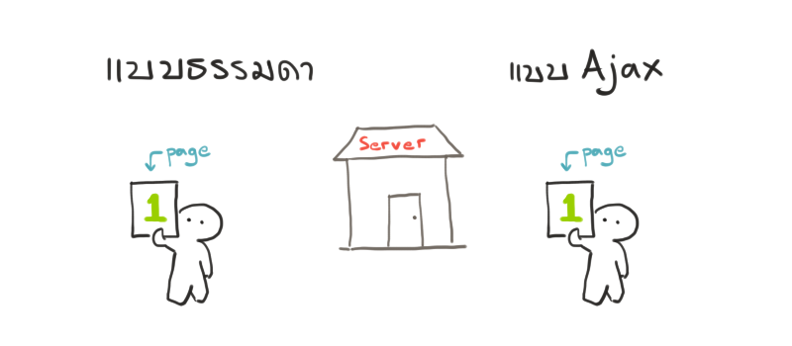

Slide 30
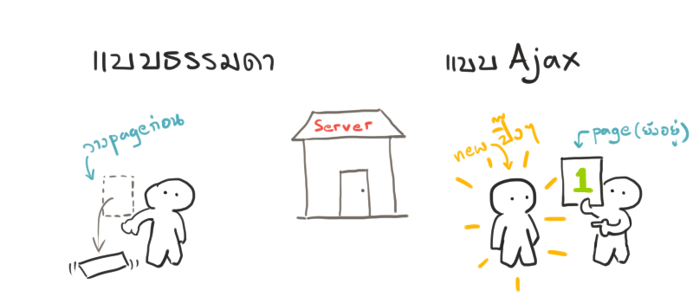

Slide 31
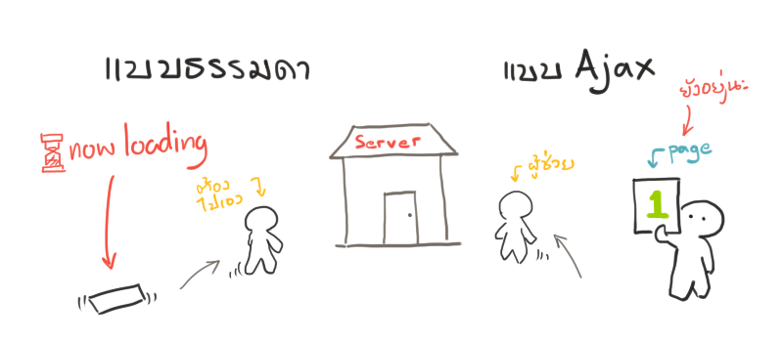

Slide 32
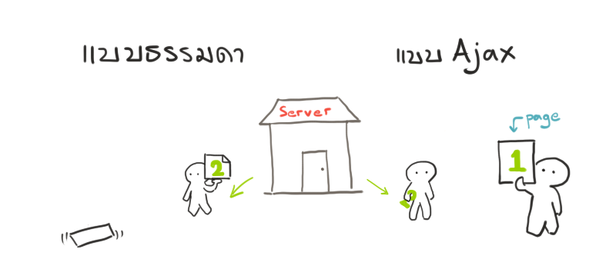

Slide 33
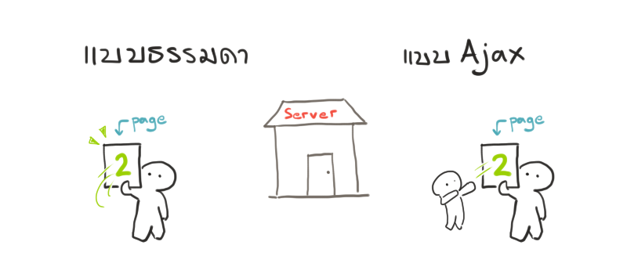

Slide 34
Ajax XHR
const xmlhttp = new XMLHttpRequest();
xmlhttp.onreadystatechange = function() {
if (xmlhttp.readyState == 4 && xmlhttp.status == 200) {
const response = JSON.parse(xmlhttp.response);
console.log(response);
}
};
xmlhttp.open('GET', 'https://www.reddit.com/.json', true);
xmlhttp.send();

Slide 35
jQuery Ajax
$.ajax({
method: 'GET',
url: 'https://www.reddit.com/.json'
})
.done((response) => {
console.log(response);
});

Slide 36


Slide 37
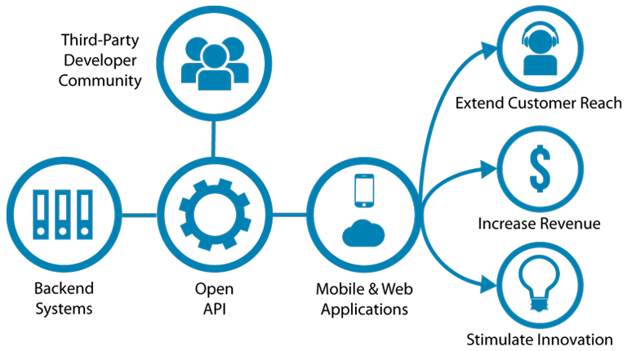

Slide 38


Slide 39
Fetch
fetch(url) // Call the fetch function passing the url of the API as a parameter
.then(function() {
// Your code for handling the data you get from the API
})
.catch(function() {
// This is where you run code if the server returns any errors
});
fetch(url)
.then((resp) => resp.json()) // Transform the data into json
.then(function(data) {
// Create and append the li's to the ul
})
})

Slide 40
XHR vs jQuery vs Fetch
$.ajax({
method: 'GET',
url: 'https://www.reddit.com/.json'
})
.done((response) => {
console.log(response);
});
const xmlhttp = new XMLHttpRequest();
xmlhttp.onreadystatechange = function() {
if (xmlhttp.readyState == 4
&& xmlhttp.status == 200) {
const response = JSON.parse(xmlhttp.response);
console.log(response);
}
};
xmlhttp.open('GET', 'https://www.reddit.com/.json', true);
xmlhttp.send();
fetch('https://www.reddit.com/.json', { method: 'GET' })
.then((res) => res.json())
.then((data) => console.log(data));

Slide 41


